Slide 1
Portafolio
Creative Process
By Cinthya Cabanzo

Slide 2
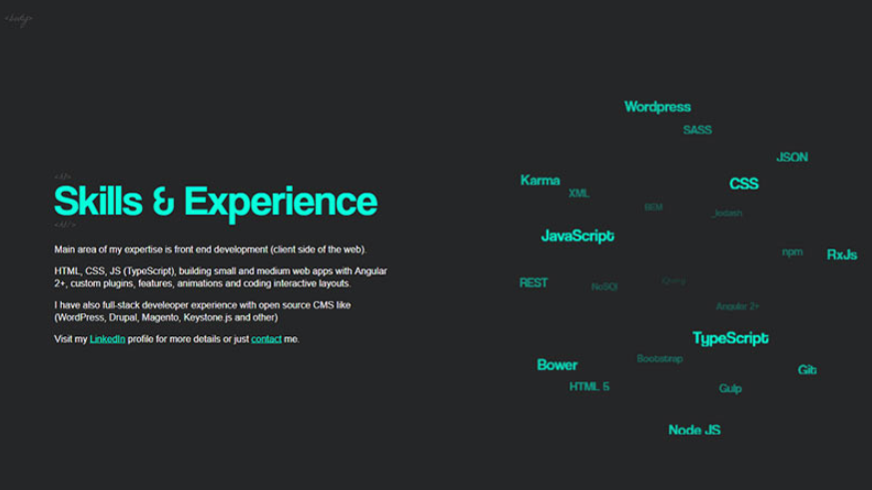


Slide 3

Notes:
<a style="background-color:black;color:white;text-decoration:none;padding:4px 6px;font-family:-apple-system, BlinkMacSystemFont, &quot;San Francisco&quot;, &quot;Helvetica Neue&quot;, Helvetica, Ubuntu, Roboto, Noto, &quot;Segoe UI&quot;, Arial, sans-serif;font-size:12px;font-weight:bold;line-height:1.2;display:inline-block;border-radius:3px" href="https://unsplash.com/@vincentiu?utm_medium=referral&amp;utm_campaign=photographer-credit&amp;utm_content=creditBadge" target="_blank" rel="noopener noreferrer" title="Download free do whatever you want high-resolution photos from Vincentiu Solomon"><span style="display:inline-block;padding:2px 3px"><svg xmlns="http://www.w3.org/2000/svg" style="height:12px;width:auto;position:relative;vertical-align:middle;top:-2px;fill:white" viewBox="0 0 32 32"><title>unsplash-logo</title><path d="M10 9V0h12v9H10zm12 5h10v18H0V14h10v9h12v-9z"></path></svg></span><span style="display:inline-block;padding:2px 3px">Vincentiu Solomon</span></a>

Slide 4
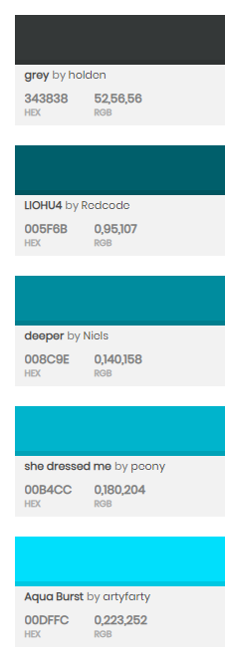
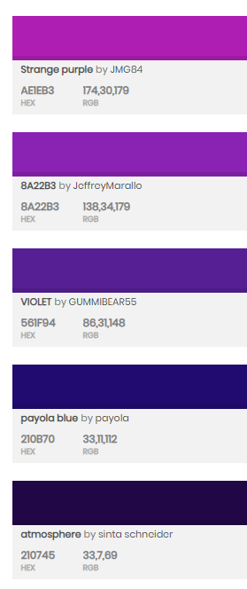
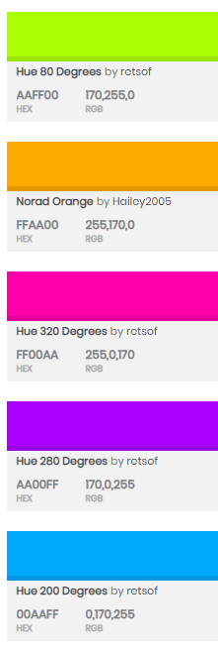
Paletas

Slide 5
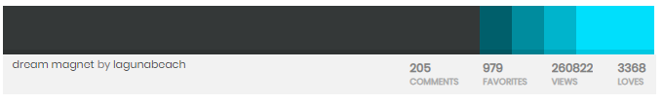
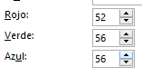
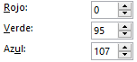
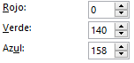
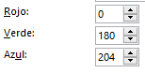
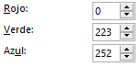
Paleta
#343838
#005F6B
#008C9E
#00B4CC
#00E9FC

Slide 6
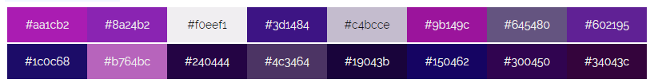
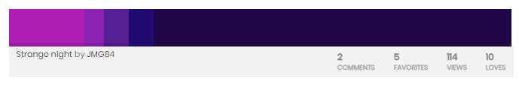
Paleta
Notes:
#aa1cb2
#8a24b2
#f0eef1
#3d1484
#c4bcce
#9b149c
#645480
#602195
#1c0c68
#b764bc
#240444
#4c3464
#19043b
#150462
#300450
#34043c

Slide 7
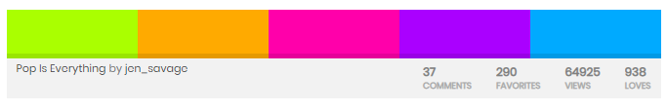
Paleta Modo Nocturno

Slide 8

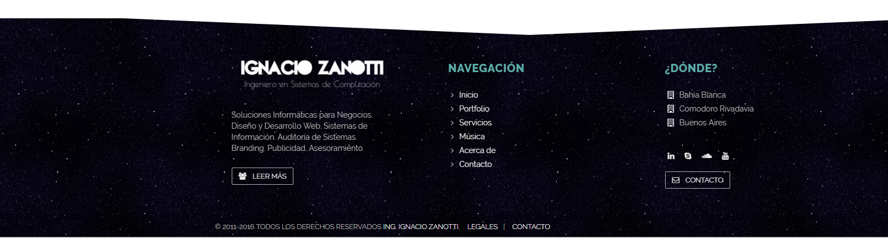
Footer
Notes:
https://www.w3schools.com/css/css3_buttons.asp
<style>
.button2:hover {
box-shadow: 0 8px 16px 0 rgba(0,0,0,0.24),0 17px 50px 0 rgba(0,0,0,0.19);
}
</style>

Slide 9
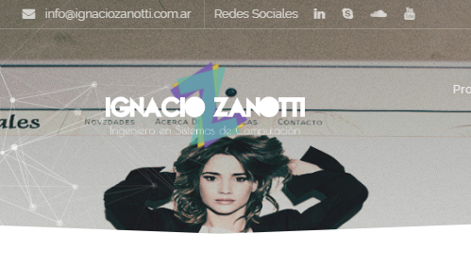
Banner Dinamico
Notes:
http://www.ignaciozanotti.com.ar/tributoweb

Slide 10

Iconos
Notes:
<div>Icons made by <a href="https://www.freepik.com/?__hstc=57440181.dd2f7117b66840b57fe64a259c87dc7b.1561213190986.1561213190986.1561213190986.1&__hssc=57440181.3.1561213190987&__hsfp=4222521352" title="Freepik">Freepik</a> from <a href="https://www.flaticon.com/" title="Flaticon">www.flaticon.com</a> is licensed by <a href="http://creativecommons.org/licenses/by/3.0/" title="Creative Commons BY 3.0" target="_blank">CC 3.0 BY</a></div>

Slide 11
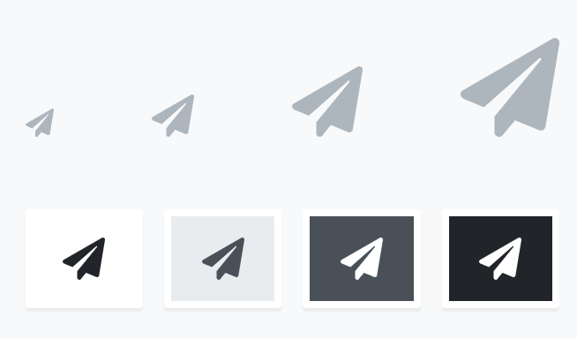
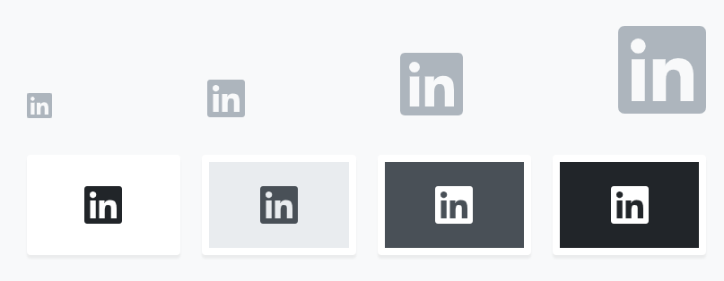
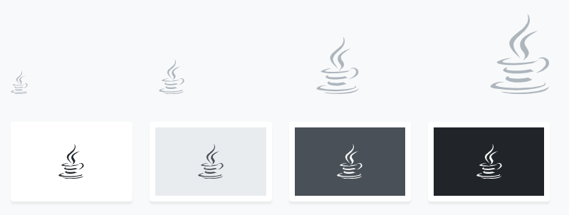
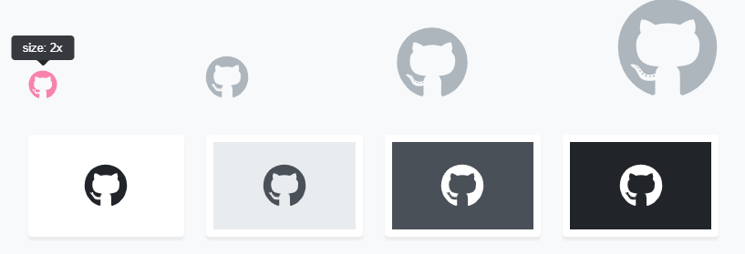
Iconos
https://fontawesome.com/
<i class="fab fa-github"></i>
<i class="fab fa-java"></i>
<i class="fab fa-linkedin"></i>
<i class="fas fa-paper-plane"></i>
<i class="fab fa-html5"></i>
<i class="fab fa-css3-alt"></i>
<i class="fas fa-copy"></i>
<i class="fas fa-lightbulb"></i>

Slide 12
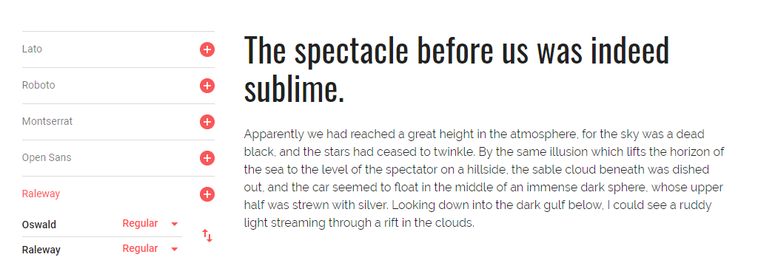
Fuentes
Notes:
https://developers.google.com/fonts/docs/getting_started
<style> @import url('https://fonts.googleapis.com/css?family=Oswald:200,300,400,500,600,700|Raleway:100,100i,200,200i,300,300i,400,400i,500,500i,600,600i,700,700i,800,800i,900,900i&display=swap'); </style>
<link href="https://fonts.googleapis.com/css?family=Oswald:200,300,400,500,600,700|Raleway:100,100i,200,200i,300,300i,400,400i,500,500i,600,600i,700,700i,800,800i,900,900i&display=swap" rel="stylesheet">
font-family: 'Oswald', sans-serif;
font-family: 'Raleway', sans-serif;

Slide 13
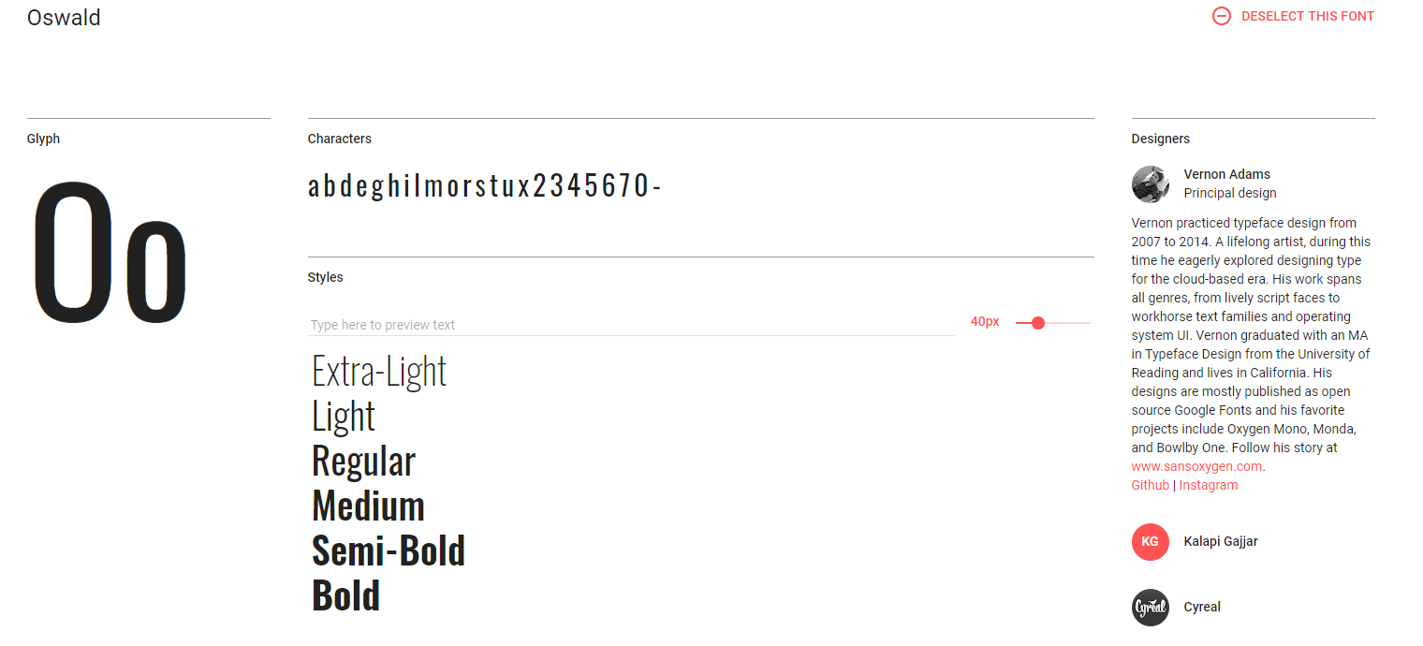
Oswald
<style> @import url('https://fonts.googleapis.com/css?family=Oswald:200,300,400,500,600,700&display=swap'); </style>
font-family: 'Oswald', sans-serif;

Slide 14
Oswald

Slide 15
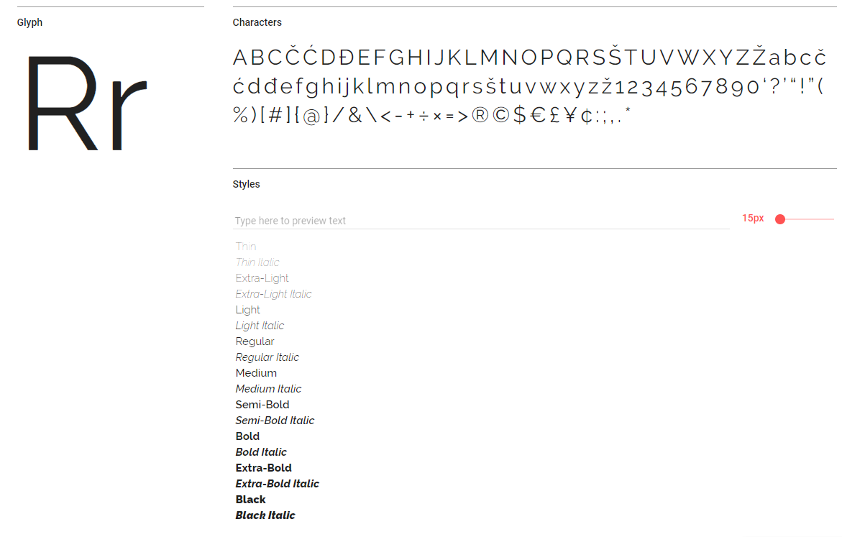
Raleway

Slide 16
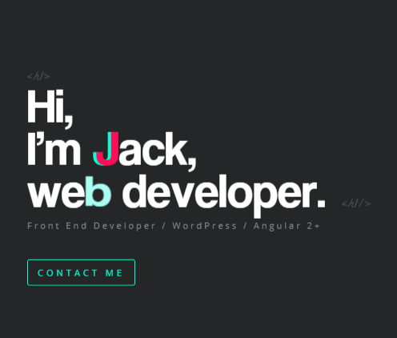
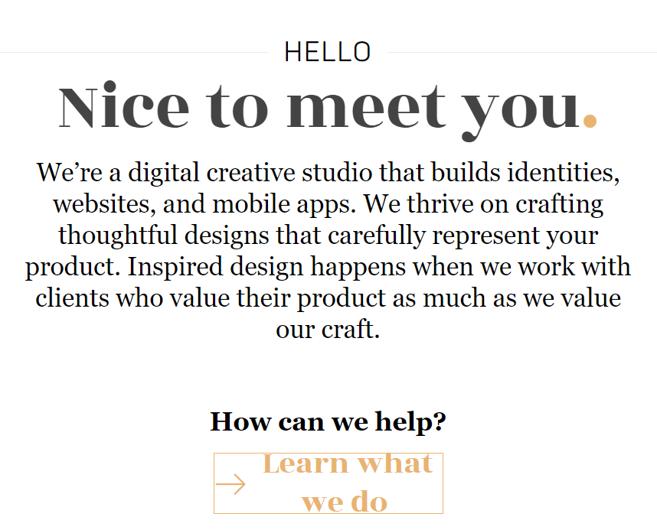
Cinthya Cabanzo
Notes:
HELLO
Nice to meet you.
We’re a digital creative studio that builds identities, websites, and mobile apps. We thrive on crafting thoughtful designs that carefully represent your product. Inspired design happens when we work with clients who value their product as much as we value our craft.

Slide 17
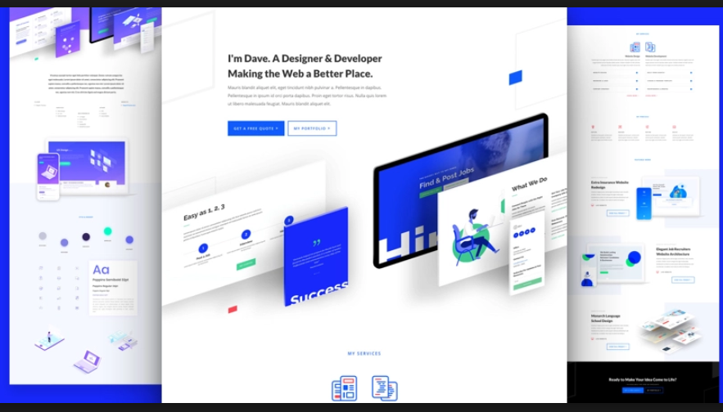
Portafolio

Slide 18
Skills
Notes:
https://jacekjeznach.com/
Identity Design
Web Development
Interface Design

Slide 19
Contacto

Slide 20

Notes:
Photo by Jean-Philippe Delberghe on Unsplash

Slide 21
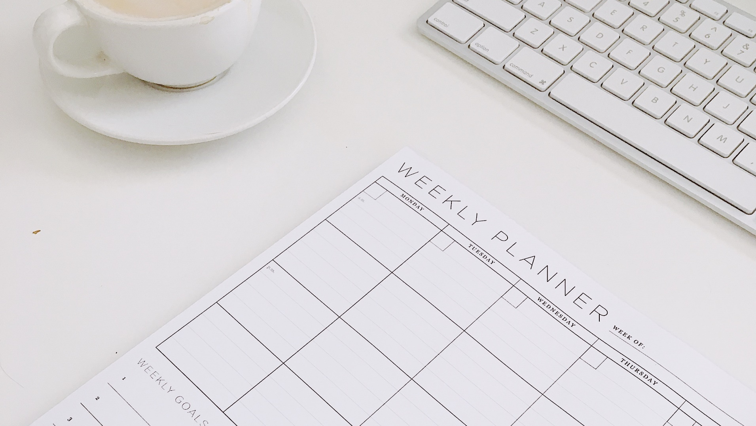
Notes:
Photo by Nikiya Christie on Unsplash

Slide 22

Notes:
Photo by Ellen Qin on Unsplash

Slide 23
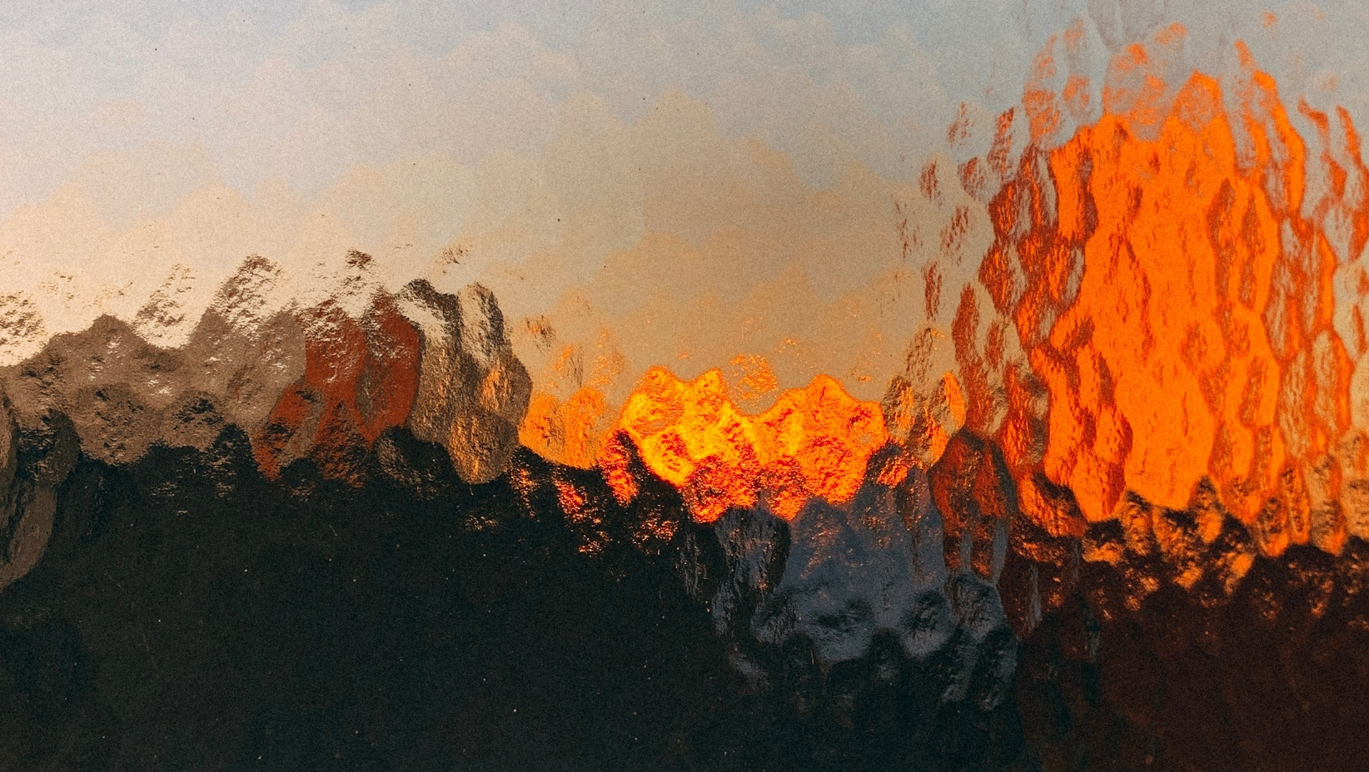
Notes:
Photo by Jonas Denil on Unsplash

Slide 24
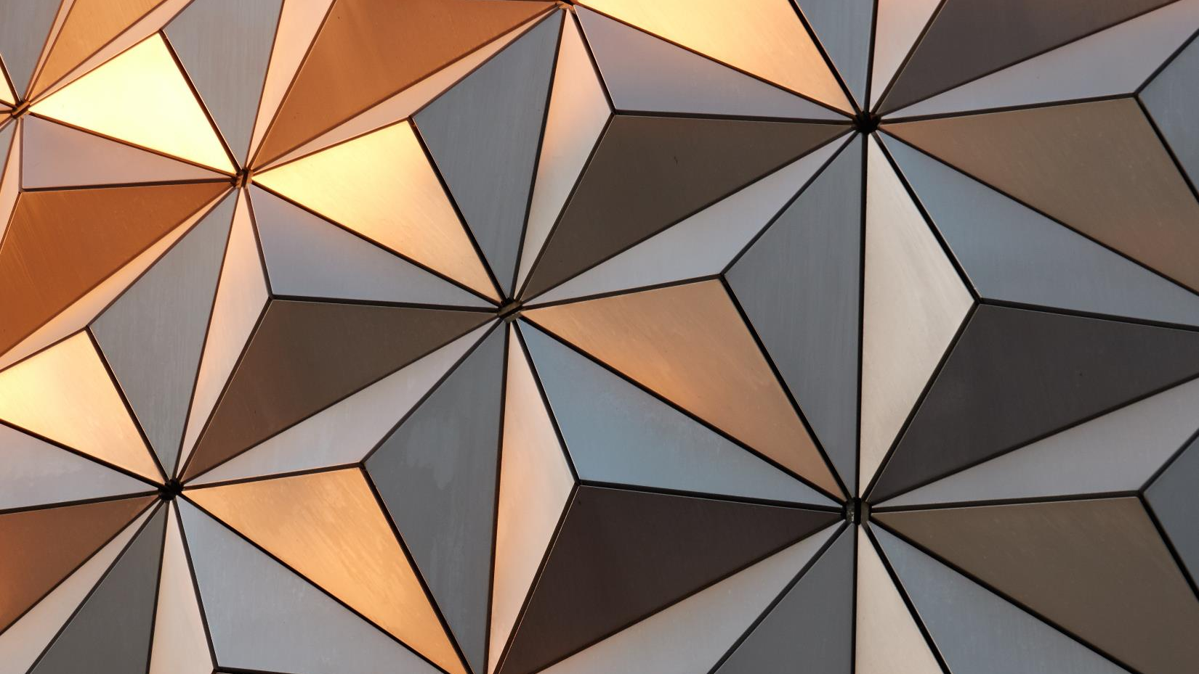

Slide 25

CINTHYA CABANZO
PORTAFOLIO
SKILLS
CONTACTO
Notes:
Photo by Anas Alshanti on Unsplash

Slide 26
CINTHYA CABANZO
PORTAFOLIO
SKILLS
CONTACTO
Notes:
Photo by Anas Alshanti on Unsplash

Slide 27

CINTHYA CABANZO
PORTAFOLIO
SKILLS
CONTACTO
Notes:
Photo by Anas Alshanti on Unsplash

Slide 28

CINTHYA CABANZO
PORTAFOLIO
SKILLS
CONTACTO
Notes:
Photo by Sharon McCutcheon on Unsplash

Slide 29
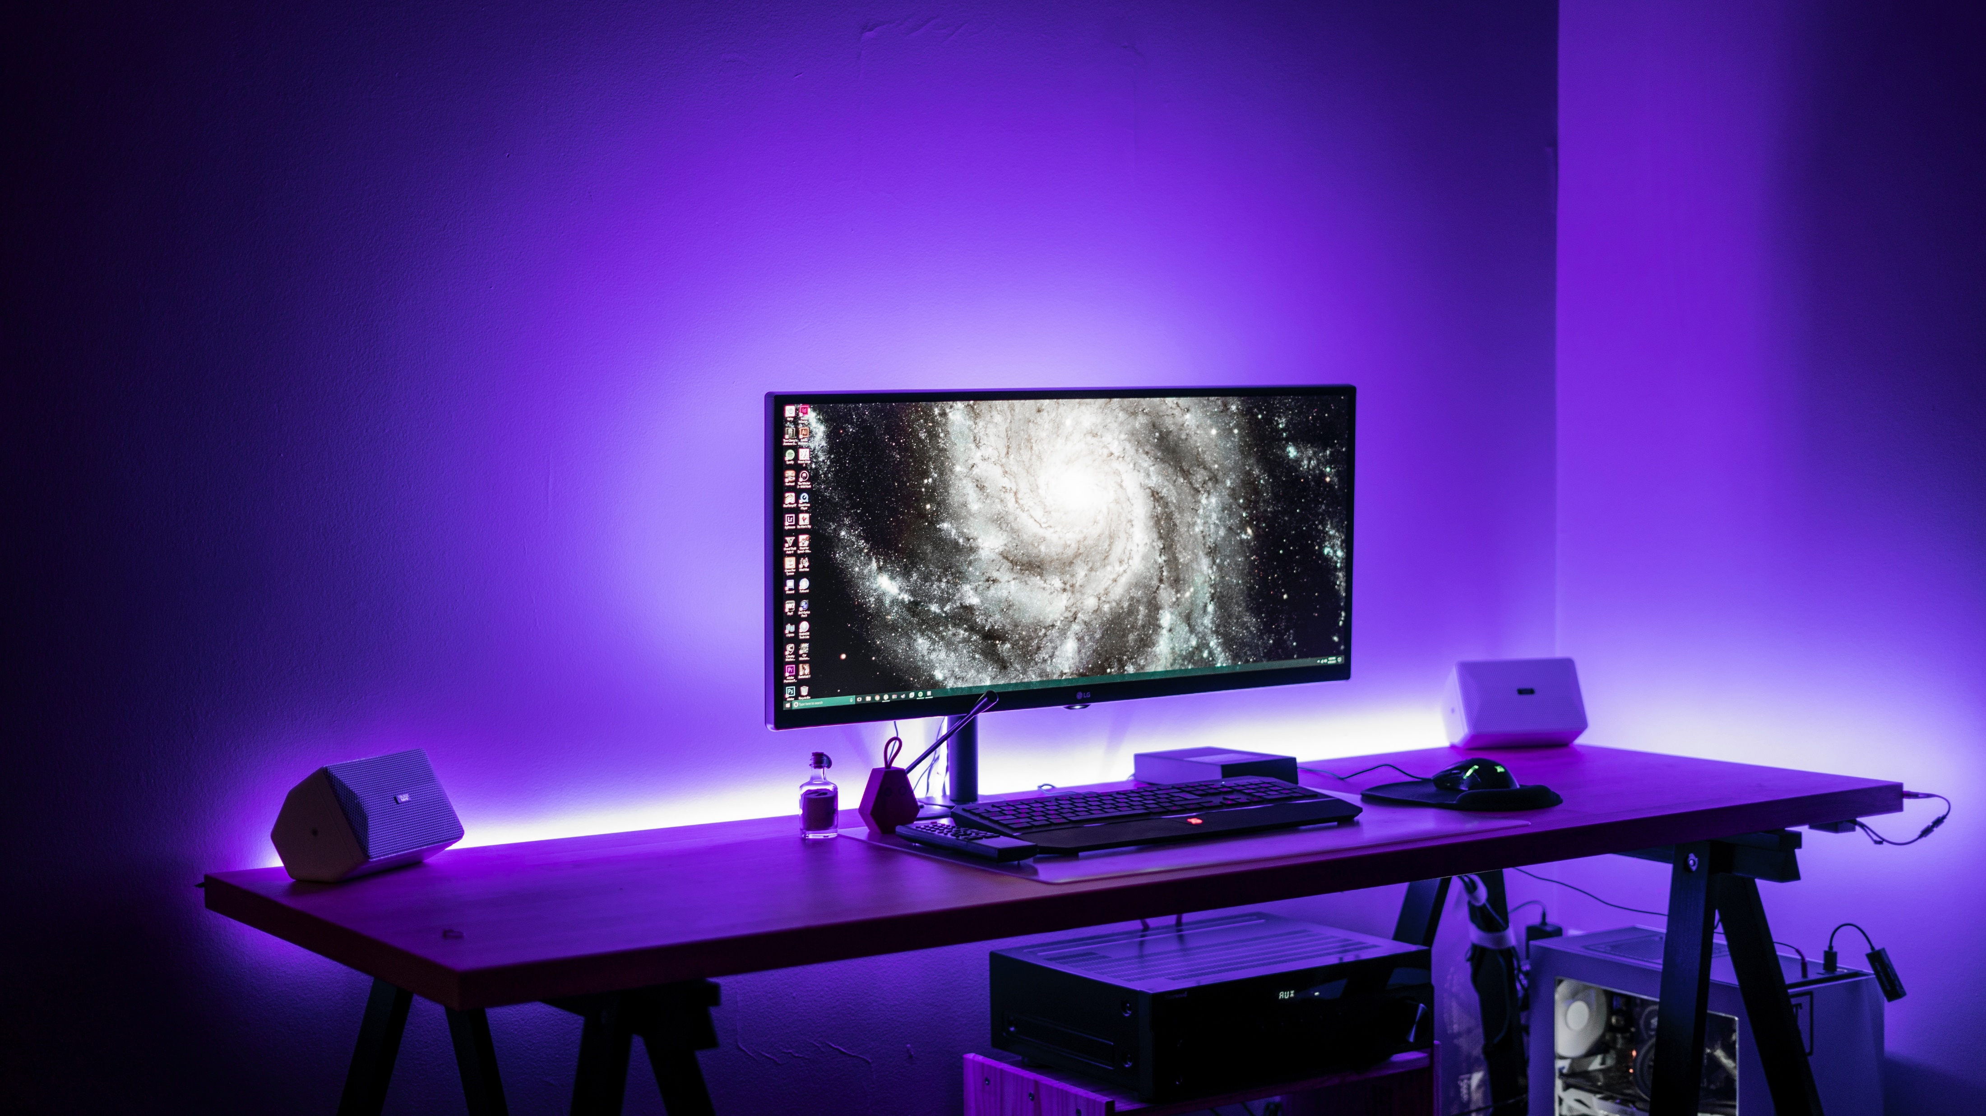
CINTHYA CABANZO
PORTAFOLIO
SKILLS
CONTACTO
Notes:
Photo by Banter Snaps on Unsplash

Slide 30
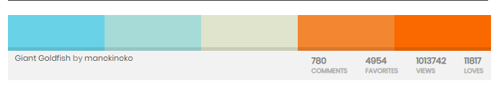
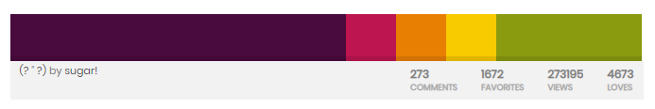
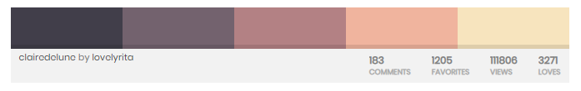
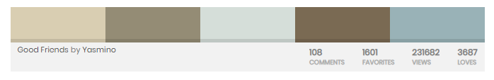
Paletas de colores

Slide 31
Referentes
https://jacekjeznach.com/
Diseño en una sola pagina:
https://www.v76.com/
Iconos flotantes y menú escondido tipo mobile
http://brianhoffdesign.com/#/work/markerly
Objetos 3d con movimiento y el cursor se transforma en un botón de play
https://locomotive.ca/en/projects/spire

Slide 32


Slide 33
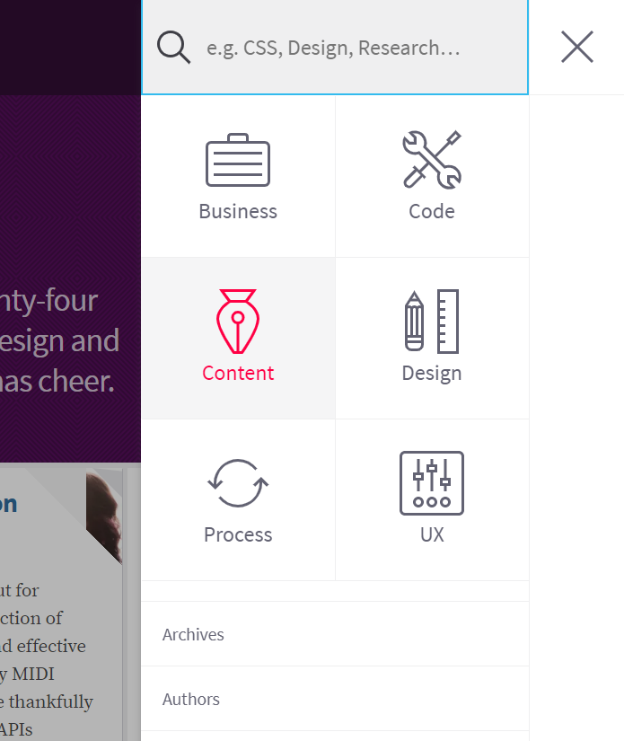
Menu Escondido

